Slide 1
CSS
MCNDHS
Ms. Eng

Slide 2
aim: how do we create shadows for our div boxes?
Do now:
Daily Grade:
On-time/attendance/not leaving the classroom: 25%
Cellphones: 25%
Notes:25%
Classwork/Homework: 25%

Slide 3
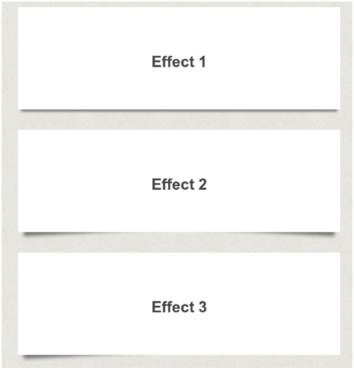
what are we learning today:

Slide 4

basics:

Slide 5

html

Slide 6
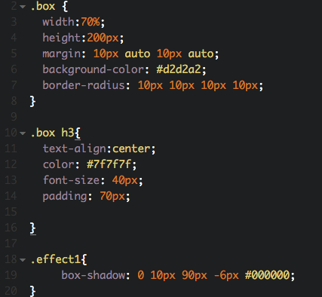
css:

Slide 7

result

Slide 8


activity:

